Slide 1
Mobile Application Development
David Drohan (ddrohan@wit.ie)

Slide 2
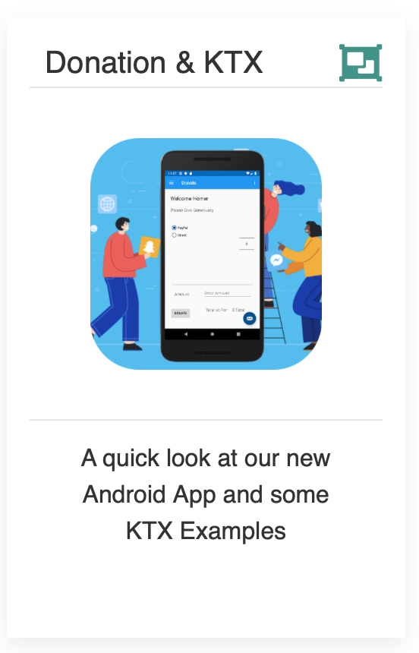
KTX in Donation

Slide 3
Donation
Let’s get Homer Elected!

Slide 4
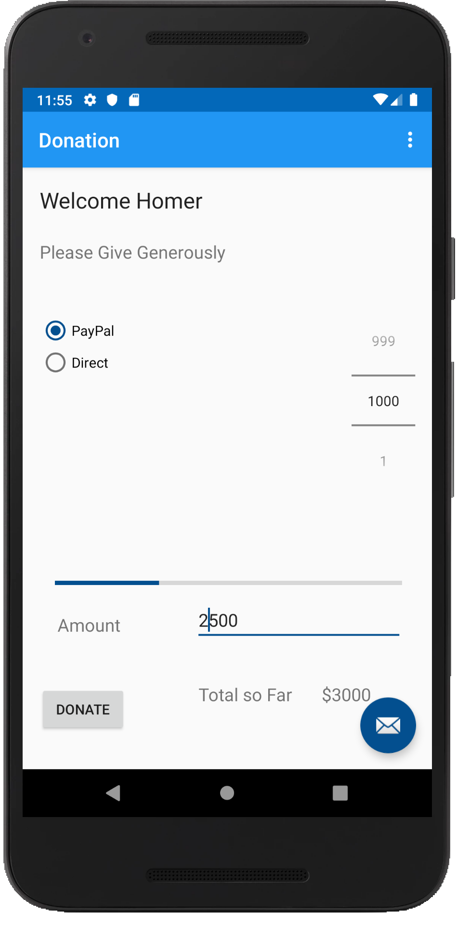
Introduction – What is Donation?
An Android App to keep track of donations made to ‘Homers Presidential Campaign ’.
App Features
Accept donation via number picker or typed amount
Keep a running total of donations
Display report on donation amounts and types
Display running total on progress bar

Slide 5
Donate Screen
This is the main (launch) screen
Single Activity
Welcome message
Multiple Widgets
NumberPicker
RadioButtons
Button
ProgressBar
EditText etc.

Slide 6
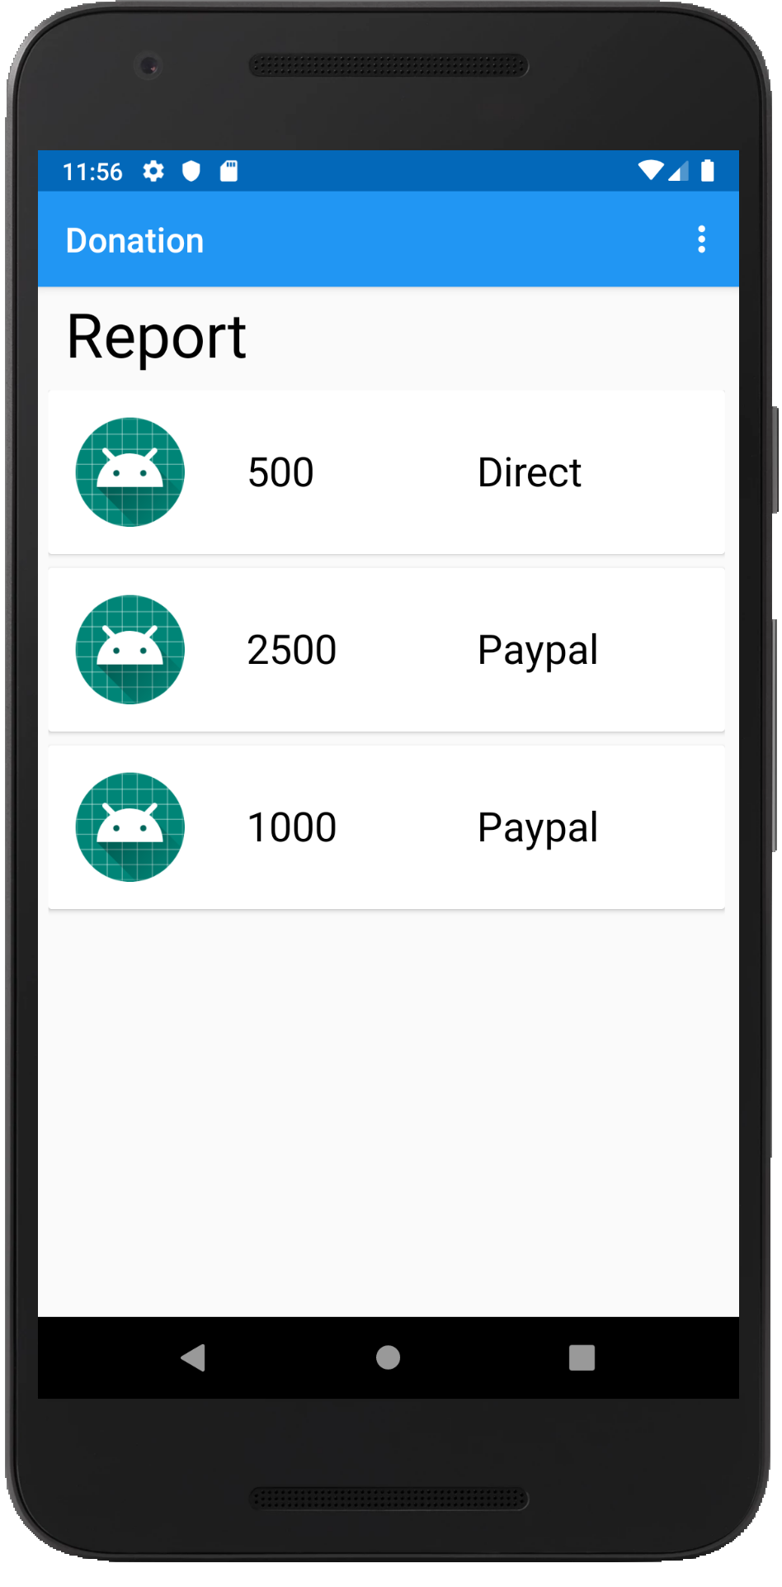
Report Screen
Single Activity:
1 TextView
1 RecyclerView
amount donated
payment type
placeholder for photo

Slide 7
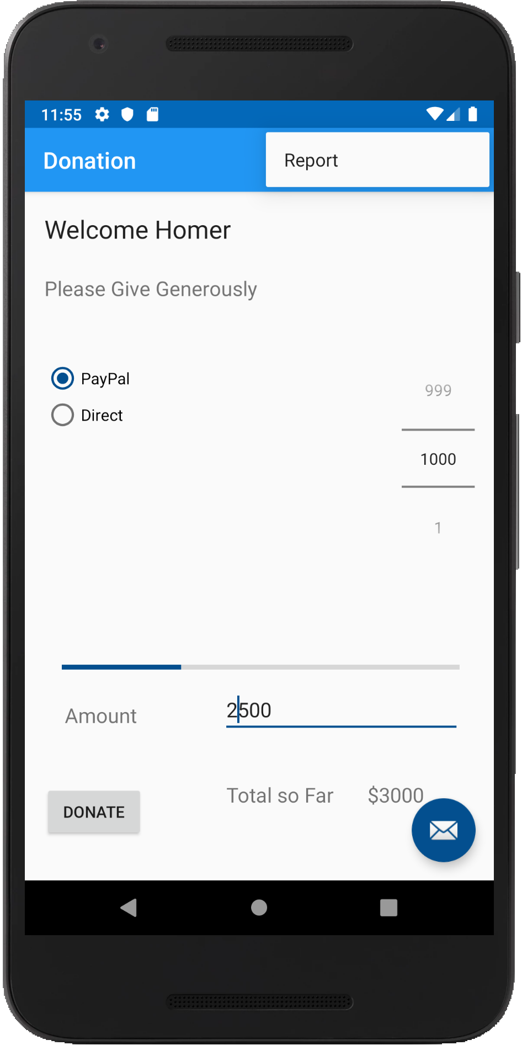
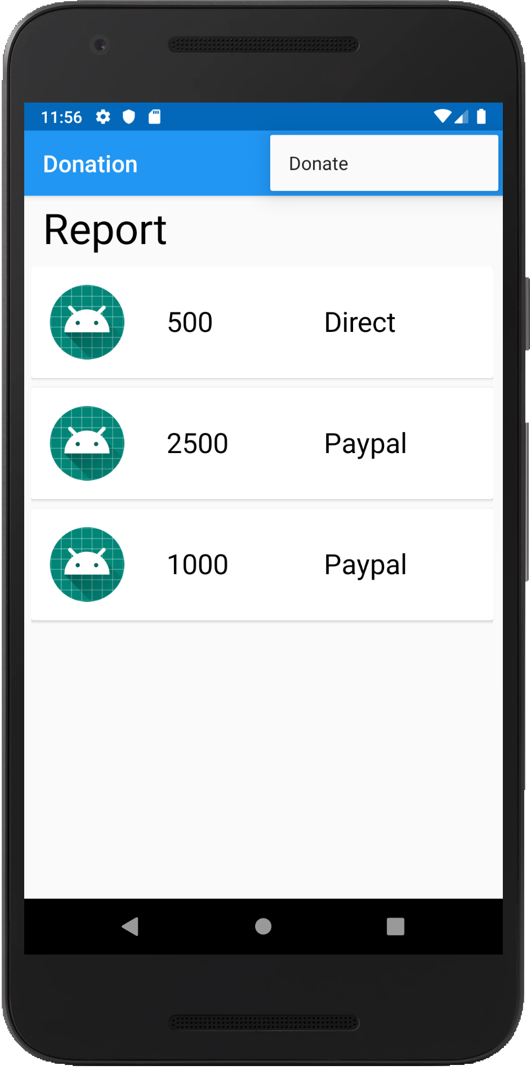
Action Bar / Menus
App has an action bar with:
Menu options to navigate between activities.
Overflow option can display other Menu Options

Slide 8

DonationKTX
intents, dialogs, logging;

Slide 9
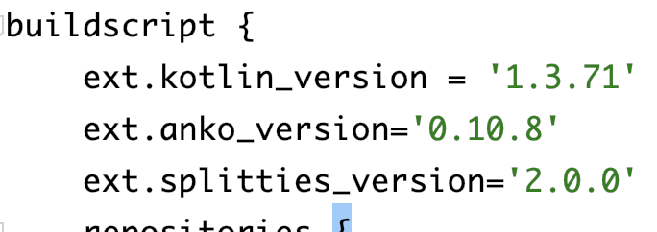
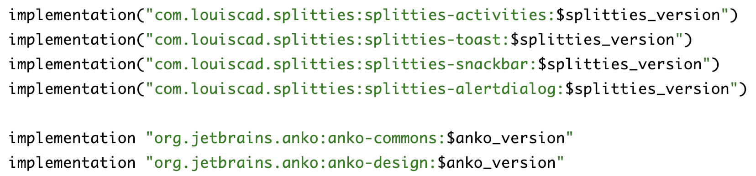
Dependencies

Slide 10
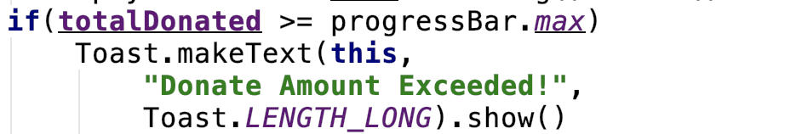
KTX Usage - Toast
Before
After

Slide 11
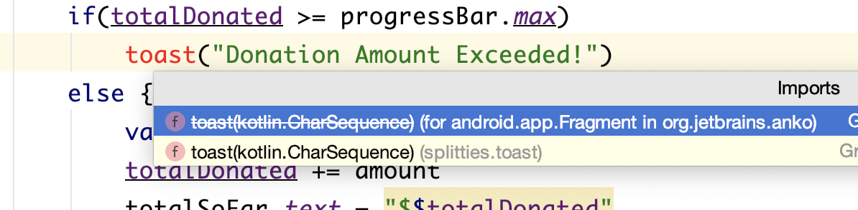
KTX Usage - Toast

Slide 12
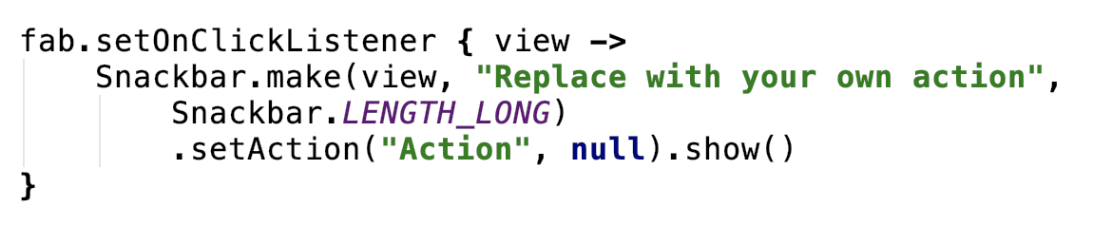
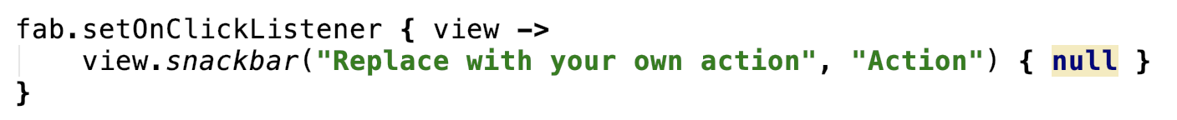
KTX Usage - Snackbar
Before
After

Slide 13
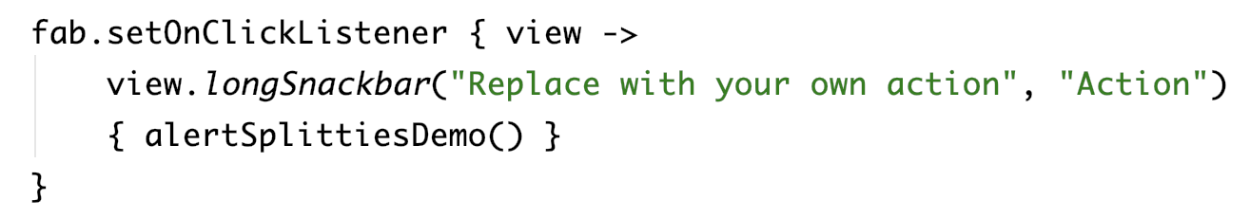
KTX Usage - Snackbar
Or

Slide 14
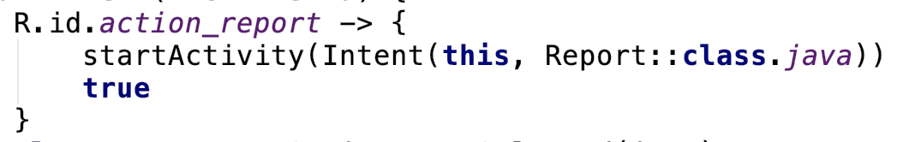
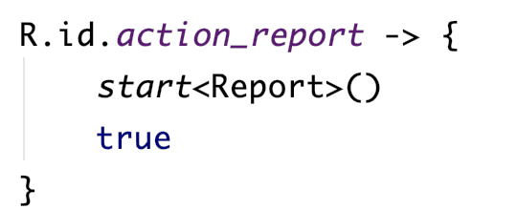
KTX Usage - Intents
Before
After

Slide 15
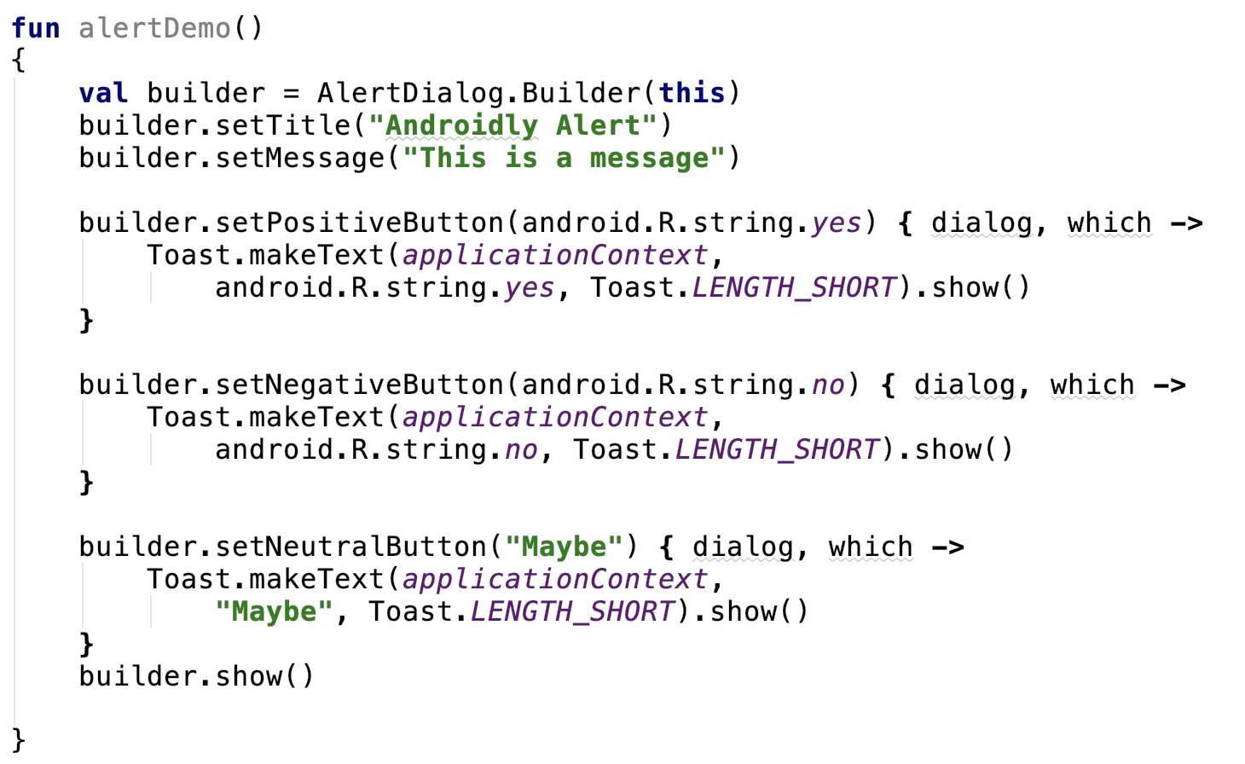
KTX Usage – Alerts (Before)

Slide 16
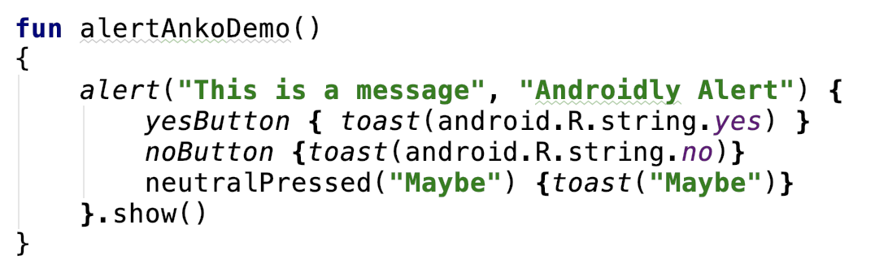
Usage – Alerts (After)

Slide 17
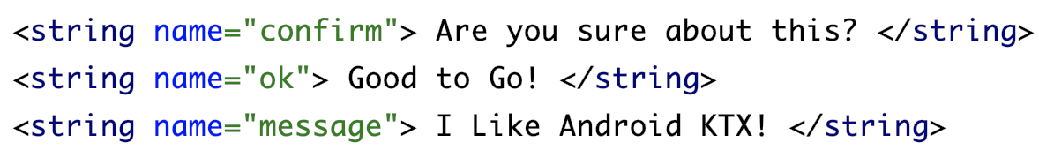
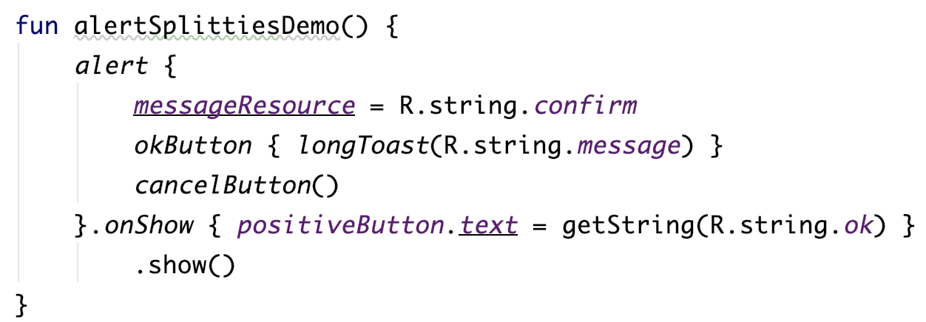
Usage – Alerts (After)

Slide 18
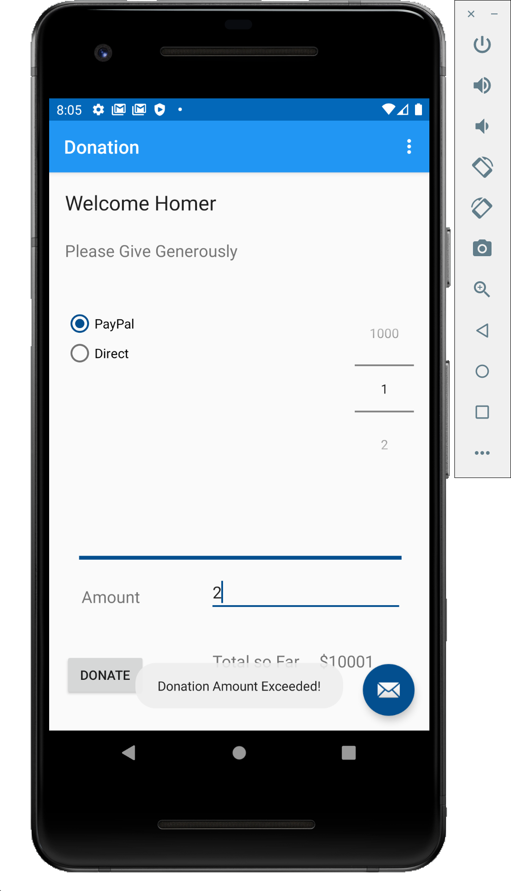
Usage – Demo
Toast

Slide 19
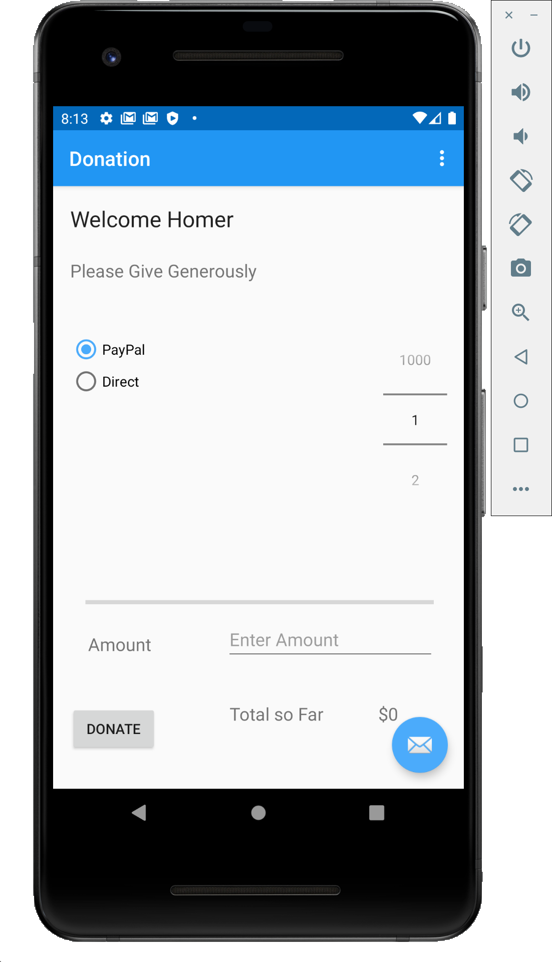
Usage – Demo
SnackBar

Slide 20
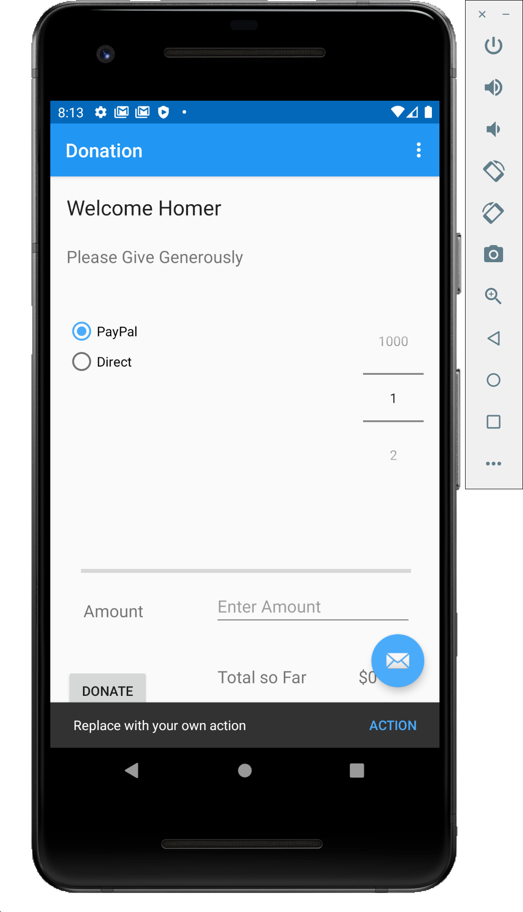
Usage – Demo
SnackBar

Slide 21
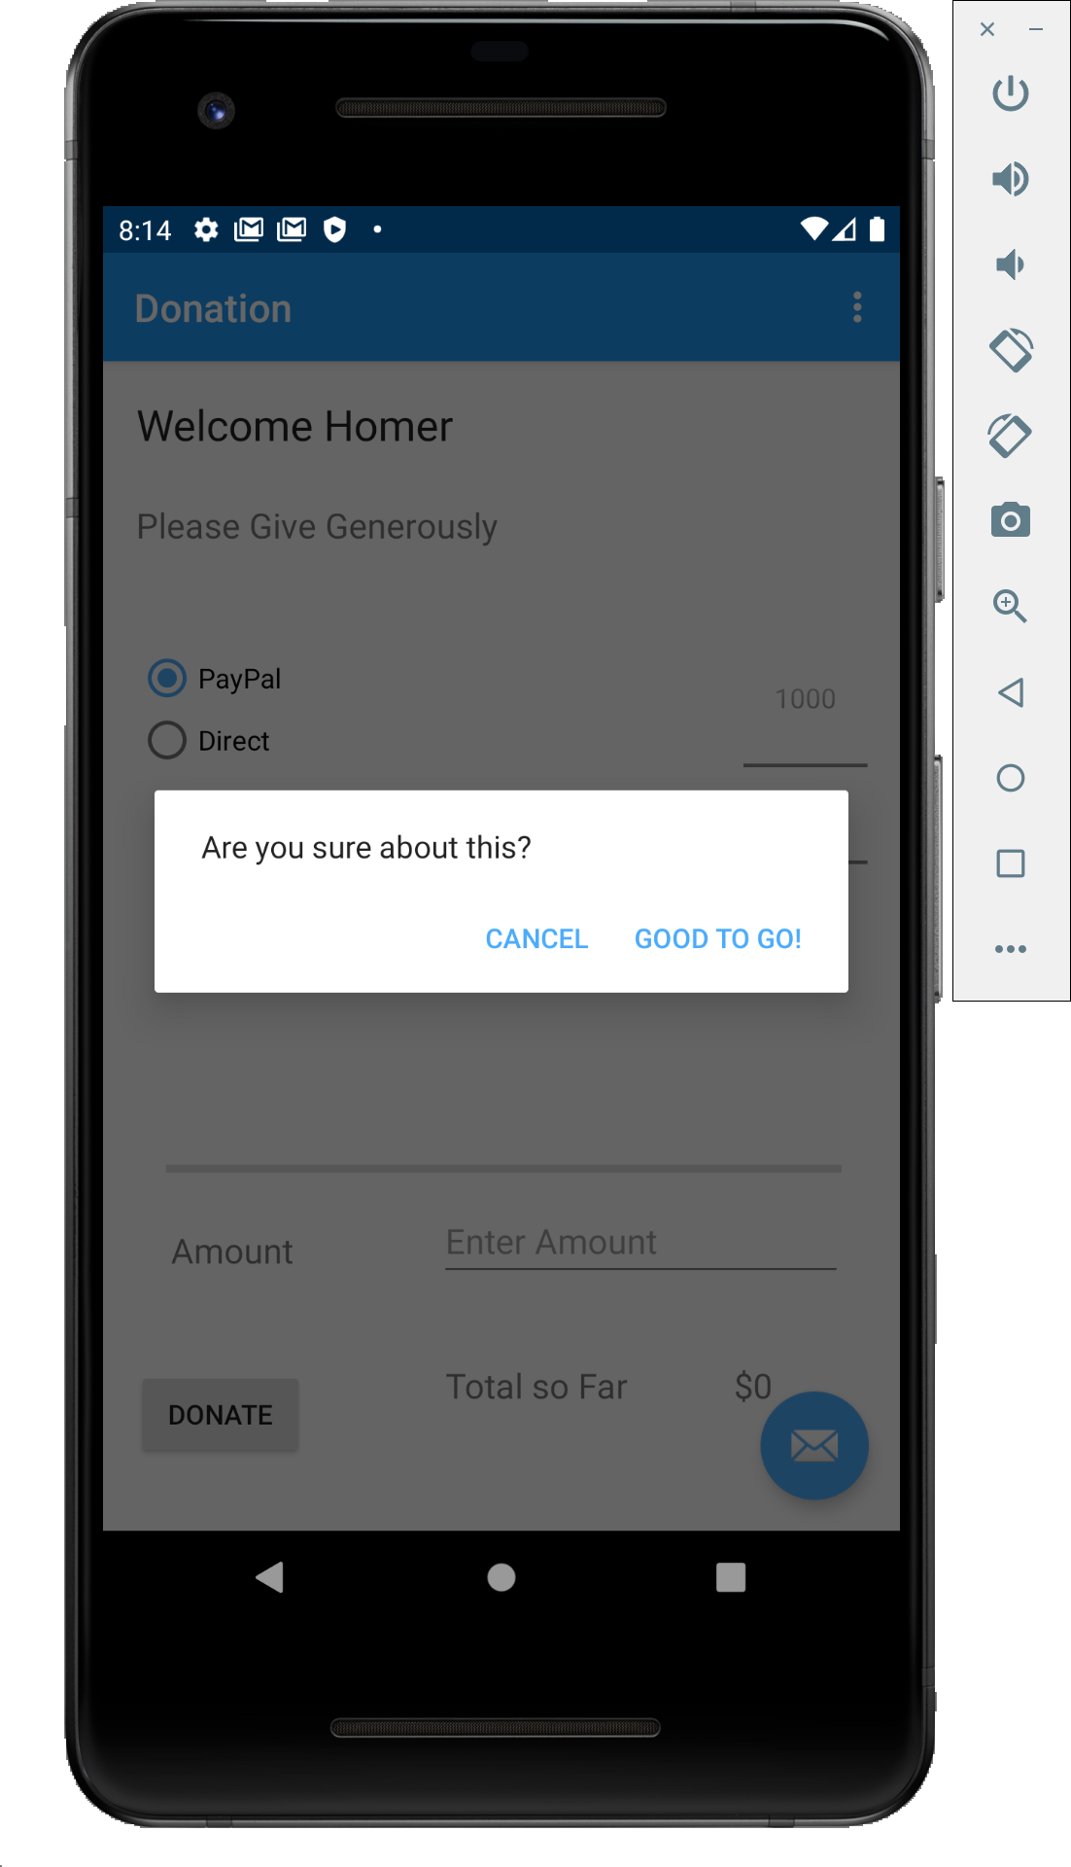
Usage – Demo
Alert

Slide 22

Usage – Demo
Alert

Slide 23

References
Sources: https://github.com/Kotlin/anko
https://adorahack.com/introduction-to-anko
https://github.com/LouisCAD/Splitties

Slide 24


